Slide 1
Systems of stratification
Chapter 6 – Sociology – Mrs. Madison

Slide 2
Social Stratification
Social Stratification:
The division of large numbers of people into layers according to their relative power, property, and prestige.
Applies to both nations and to people within a nation, society, or other group.
Sociological Significance
Affects our life chances
Affects the way we think about life

Slide 3
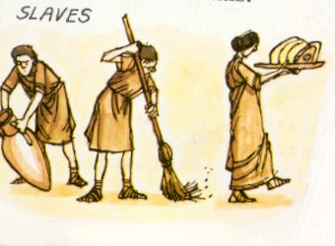
Slavery
Slavery: A form of social stratification in which some people own other people.
Has been common throughout history
Causes
Debt
Crime
War

Slide 4
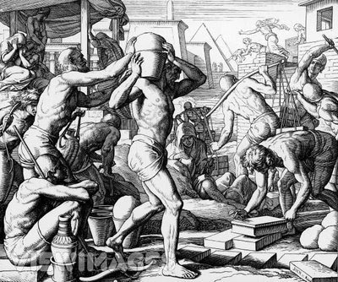
Slavery
Conditions
In some places, slavery was temporary
Slavery was not necessarily inheritable
Slaves were not necessarily powerless and poor

Slide 5
Slavery
In the New World
Indentured Servitude:
A contractual system in which someone sells his or her services for a specific period of time
Voluntarily entered into
Racism and Slavery
Ideology: Beliefs about the way things ought to be that justify a social arrangement

Slide 6
Caste
Caste System: A form of social stratification in which one’s status is determined by birth and is lifelong
Endogamy: The practice of marrying within one’s social group

Slide 7
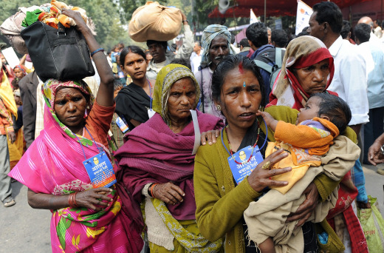
Caste
India’s Religious Castes
Four Major Castes
Brahman (Priests and Teachers)
Kshatriya (Rulers and Soldiers)
Vaishya (Merchants and Traders)
Shudra (Peasants and Laborers)
Dalit (Untouchables)
Notes:
The Indian government formally abolished the caste system in 1949, but it remains part of every day life.

Slide 8
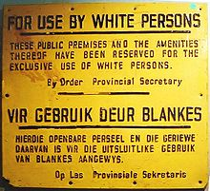
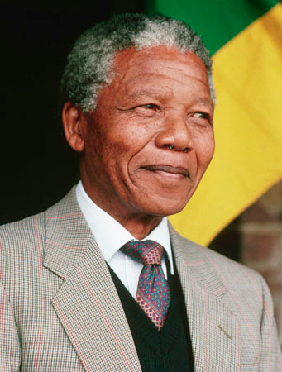
Caste
South Africa’s Apartheid
Apartheid: The separation of racial-ethnic groups practiced in South Africa

Slide 9
Estate
Estate Stratification System: The stratification system of medieval Europe, consisting of three groups or estates: the nobility, the clergy, and commoners

Slide 10
Class
Class System: A form of social stratification based primarily on the possession of money or material possessions
Social Mobility: Movement up or down the social class ladder

