Slide 1
Socialization into gender
Sociology - Chapter 3 – Mrs. Madison

Slide 2
Gender Socialization
The ways in which society sets children onto different courses in life because they are male or female

Slide 3
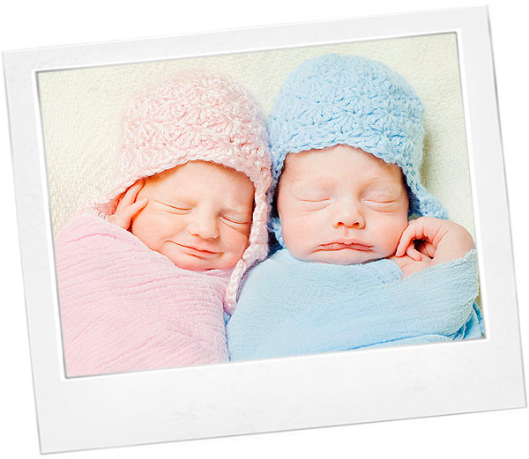
Gender Messages in the Family
Our parents are the first significant others who teach us gender messages

Slide 4
Gender Messages in Family
Goldberg and Lewis Study (1969)
Mothers in our society subconsciously reward daughters for being passive and dependent, and sons for being active and independent.
Some sociologists attribute the differences Goldberg and Lewis observed to biology.

Slide 5
Gender Messages from Peers
Peer Group: A group of individuals of roughly the same age who are linked by common interests.
Girls tend to reinforce images of appearance and behavior they think are appropriate for females
Boys often use media images to develop their identity – repeating movie lines, acting out jokes, etc.

Slide 6
Gender Messages in Mass Media
Mass Media: Forms of communication, such as radio, newspapers, and television that are directed to mass audiences.
Gender Roles: The behaviors and attitudes considered appropriate because one is a female or male.

