Slide 1
Groups
Chapter 4 – Social Structure and Social Institutions

Slide 2
Groups
A group consists of people who have something in common and believe that what they have in common is significant
When we belong to a group, we choose to uphold the group’s norms, values, and interests
We also give others the right to judge how well we uphold these

Slide 3
Societies and Their Transformation
Society: People who share a culture and a territory
Sociologists believe that the type of society we live in is the fundamental reason for why we become who we are

Slide 4
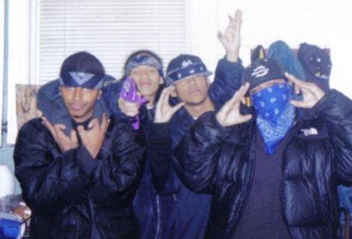
Groups Within Society
Primary Group:
A small group characterized by intimate, long-term, face-to-face association and cooperation
Offer a sense of belonging and being appreciated
Values and attitudes become part of our identity
Gangs are an example of a primary group

Slide 5
Groups Within Society
Secondary Groups:
Larger, more anonymous, more formal, and more impersonal than primary groups
Based on shared interests or activities
Relatively temporary
Tend to break down into primary groups
Ex: At school and work, we form friendships

Slide 6
Groups Within Society
In-Groups and Out-Groups
In-Groups: Groups toward which one feels loyalty
Positive Consequences: Love, encouragement, overlooking faults
Shape our view of right and wrong and our behavior
Out-Groups: Groups toward which one feels antagonism
Negative Consequences: Discrimination, prejudice, hatred

Slide 7
Social Networks
Social Network: The social ties radiating outward from the self that link people together
Clique: A cluster of people within a larger group who choose to interact with one another

